Slide 1
DOG BREED CLASSIFICATION
Prof. Waleed Youssef
DATA 603 Platforms for Big Data Processing
Project Final Delivery
By,
Sujeeth Sithagari, Ajay Rajaram, Suryateja Avvaru

Slide 2
Contents
Description Of The Project & Problem Statement
Project Implementation
Implemented And Not Implemented
Dataset
Project Workflow Diagram
Data Collection
Mongodb
Visualizations And Results
Observations
Conclusion & Lesson’s Learnt
References

Slide 3
Description of the Project
Developed a sophisticated image classification system aimed at accurately identifying and categorizing dog breeds through by leveraging big data tools like PySpark, MongoDB.
To enhance veterinary care by providing precise breed information crucial for treatment planning.
To assist pet owners and adoption agencies in identifying suitable dogs, reducing mismatches and improving adoption success.
Problem Statement
Manual dog breed identification is error-prone and can lead to serious misconceptions about a dog's behavior and health needs.
Potentially causing adoption mismatches and inadequate care, impacting animal welfare and owner satisfaction.
To leverage advanced machine learning models and big data technologies to create a reliable system that enhances understanding of breed-specific traits and improves outcomes for dogs and their caretakers

Slide 4
Project Implementation
Sourced image data from Kaggle which is then loaded into MongoDB.
Utilized PySpark and MongoDB for robust and scalable data handling.
Employed OpenCV for initial image processing, including resizing and format standardization.
Further data cleaning and preprocessing were conducted using PySpark, ensuring the data was optimized for model training.
Developed a Convolutional Neural Network (CNN), tailored for high accuracy in image classification tasks.
The model architecture was designed to effectively learn from thousands of images across numerous dog breeds.
Trained the model on a large dataset of 100000 images, progressively validating and tuning to improve accuracy and reduce overfitting.
Utilized Spark's MLlib for additional machine learning tasks, enhancing the model's learning capabilities.

Slide 5
Project Defense and Progress report tasks that are implemented/ not implemented
Successfully utilized an advanced technology stack including Python, PySpark, and MongoDB as outlined in the project defense and report.
Opted for matplotlib over Tableau for data visualization to allow for more integrated and customizable graphics within the Python ecosystem.
Conducted thorough model evaluation using accuracy rates and confusion matrices to assess performance.
Encountered complexities with using Cloudera for Python code integration; found it less accommodating compared to other platforms. Conversely, Scala provided a more robust environment for our Python-based implementations, enhancing our workflow and efficiency.

Slide 6
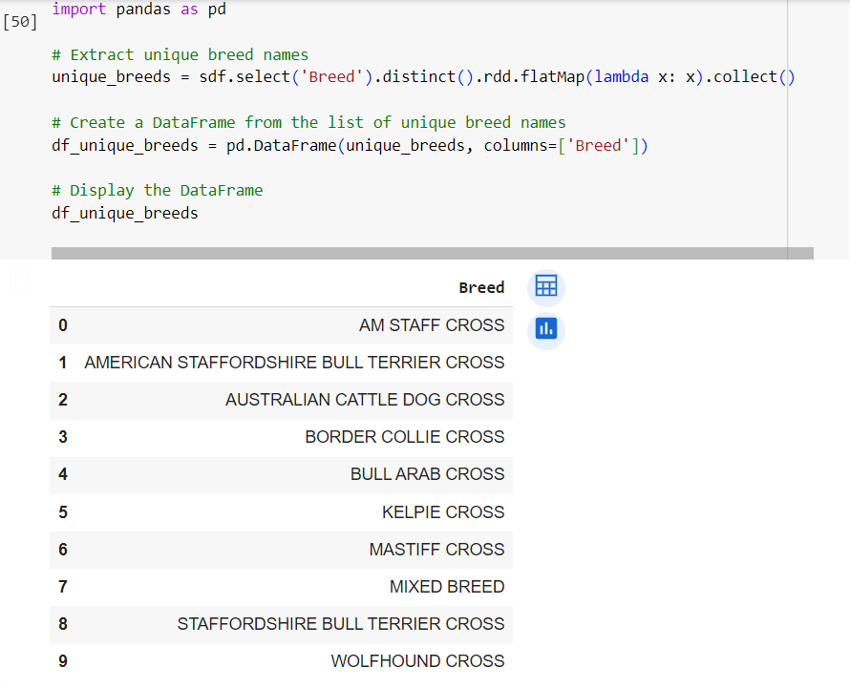
DATASET
Obtained the dataset from Kaggle of size 20GB.
The dataset comprises images of dogs labeled by their respective breeds of 10 classes.
The dataset includes both a CSV file and a folder containing JPEG image files.
CSV Attributes:
DogId: A unique identifier for each dog. Multiple rows may share the same DogId.
Breed: The breed name or label as advertised on the website.
Image: File name of the JPEG image stored in the accompanying folder.
Image number: An attribute ranging from 1 to 10, denoting the sequence number of the image associated with a particular DogId

Slide 7
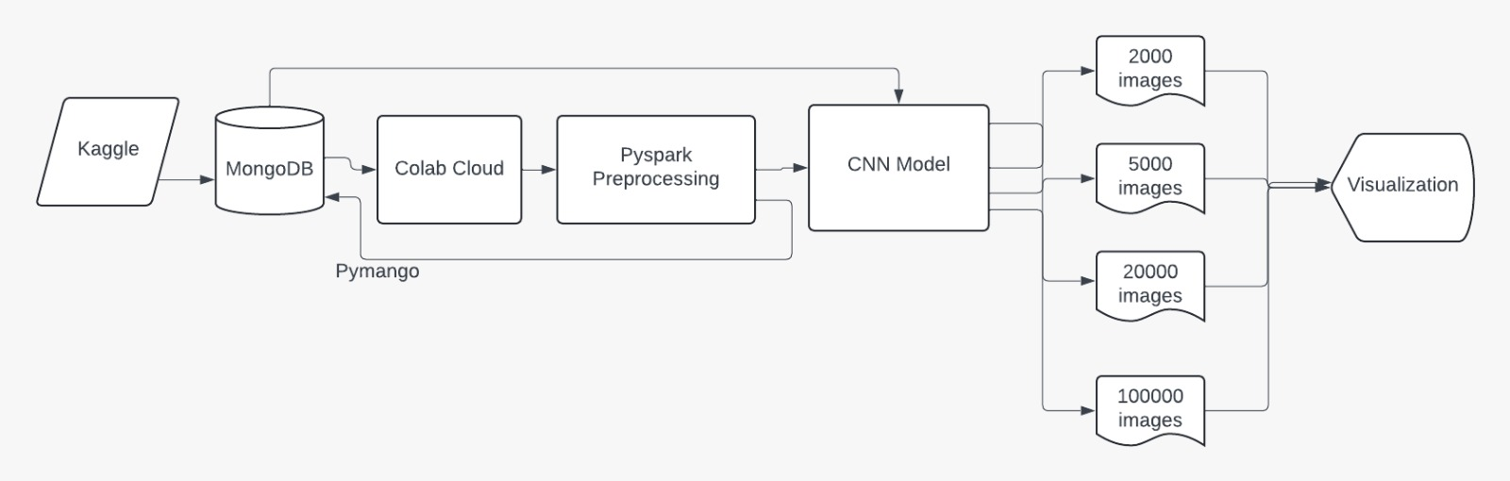
Project Work Flow diagram

Slide 8
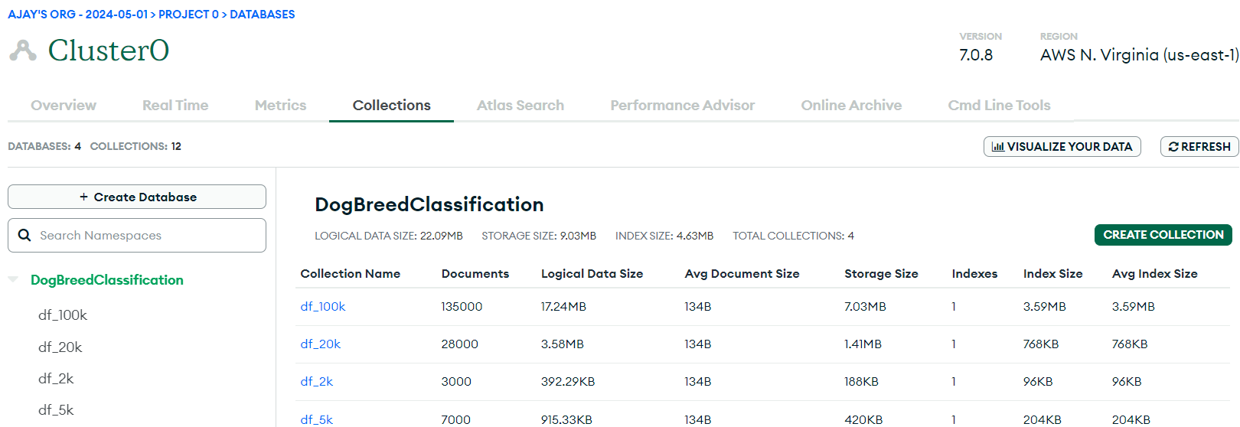
Data Collection
Loaded the image data (from Kaggle) into the "DogBreedClassification" collection within the MongoDB database.
Created a MongoDB Database housing datasets of varying sizes: 2000, 5000, 20000, and 100000 rows of image data.
Established a connection to the MongoDB cluster utilizing the pymongo library.

Slide 9
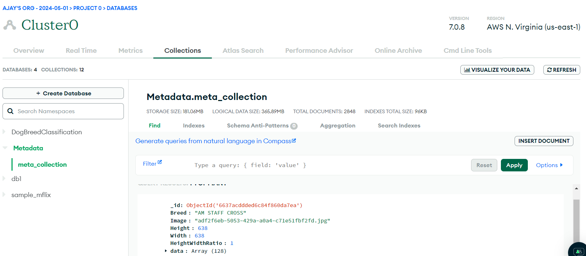
Metadata (Processed data) To Mongodb
The data which is preprocessed has been stored in the MongoDB.

Slide 10
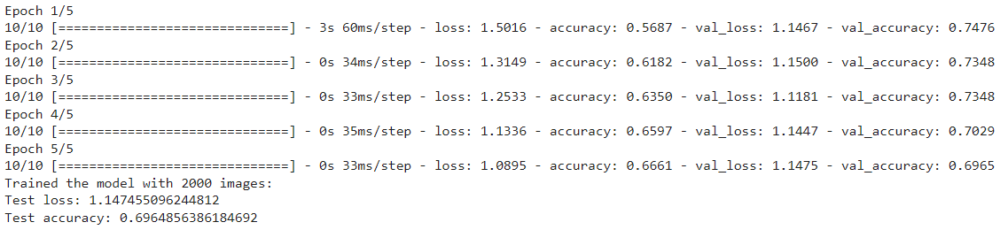
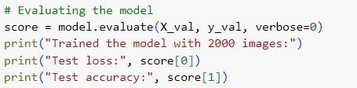
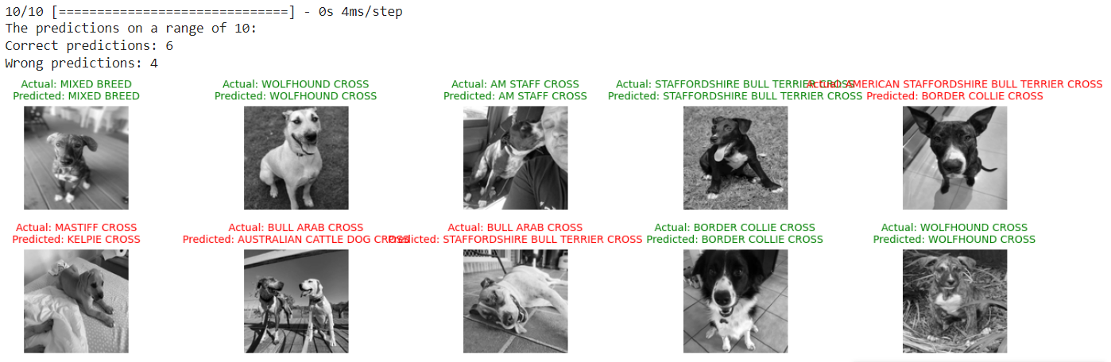
Visualizations & Results for 2000 image Dataset

Slide 11
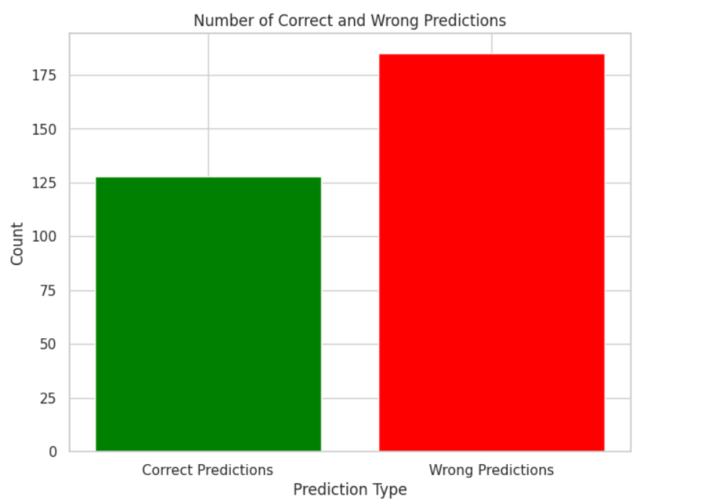
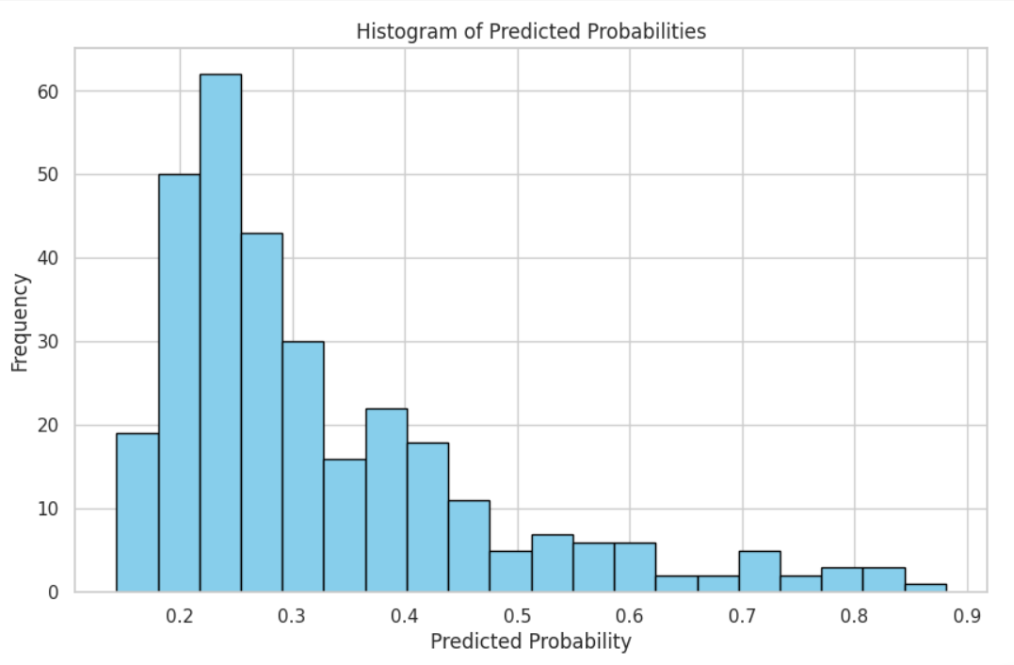
Visualizations & Results for 2000 image Dataset

Slide 12
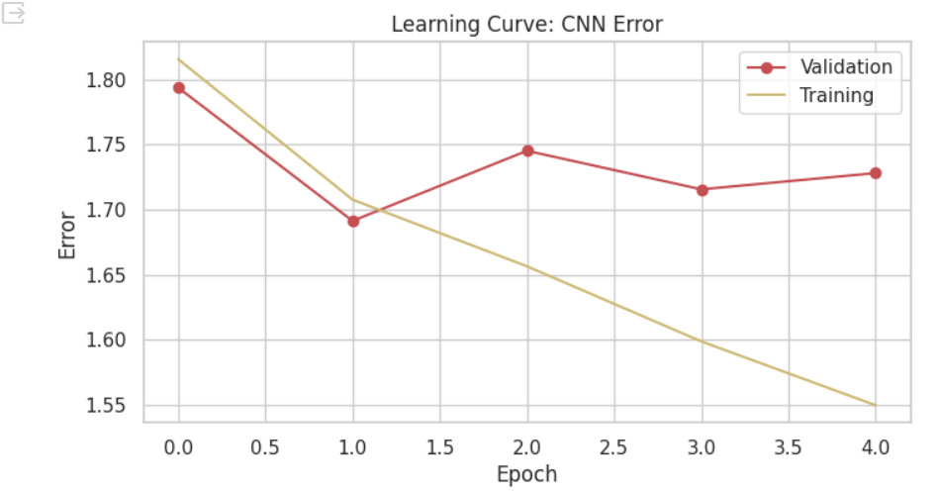
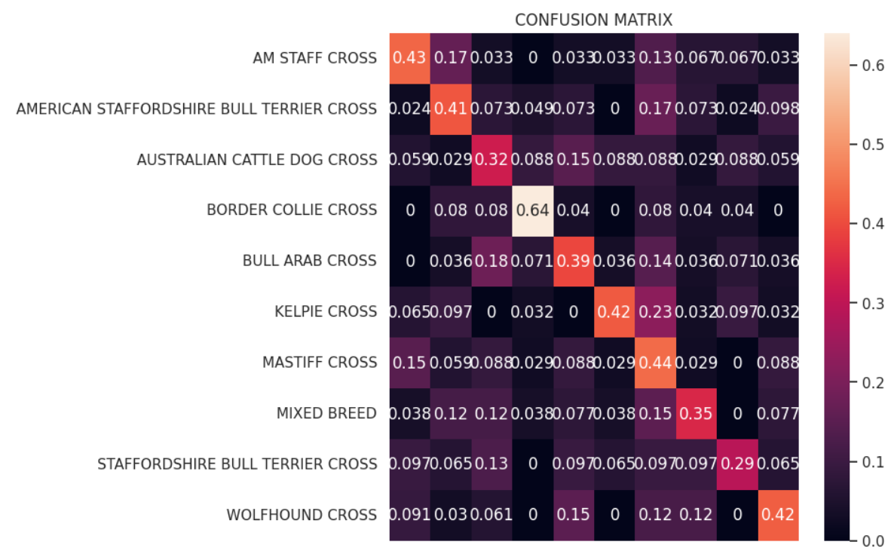
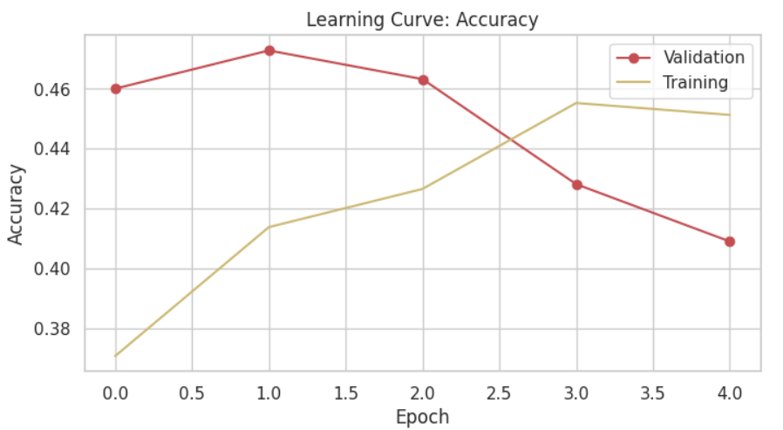
Visualizations & Results for 2000 image Dataset

Slide 13
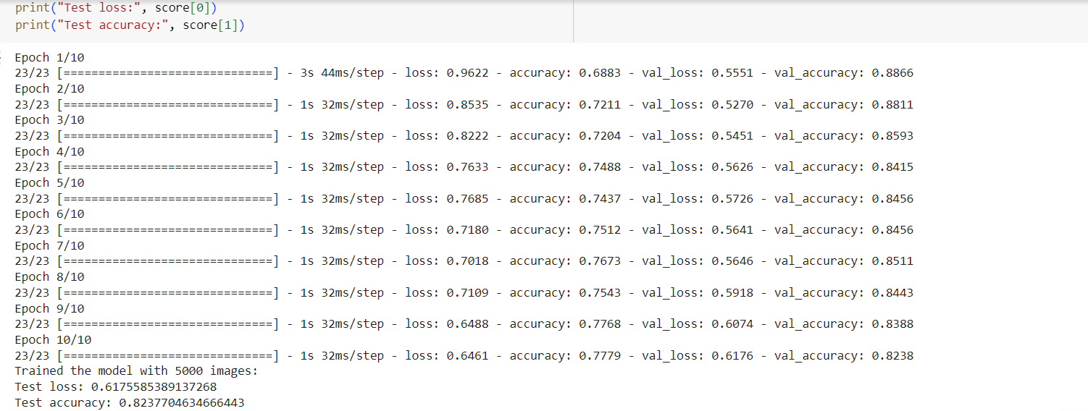
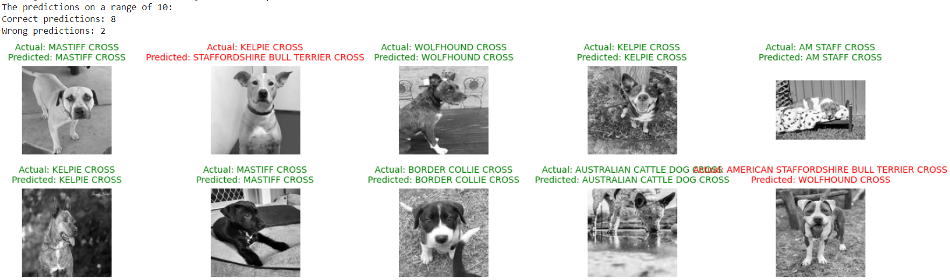
Visualization for 5000 image Dataset

Slide 14
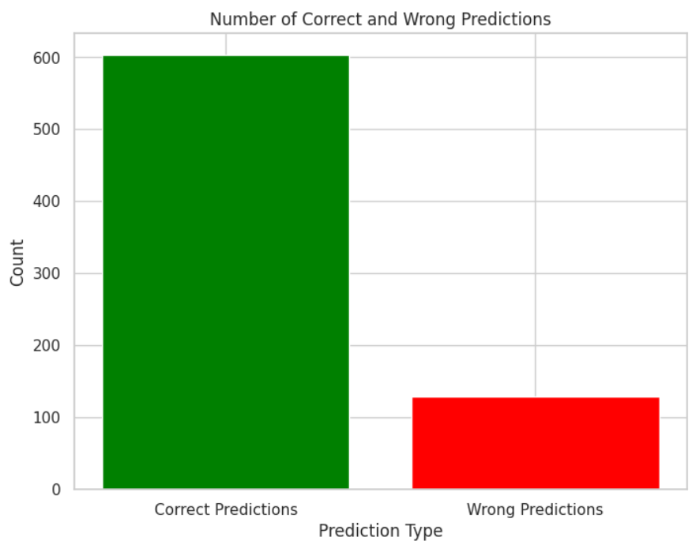
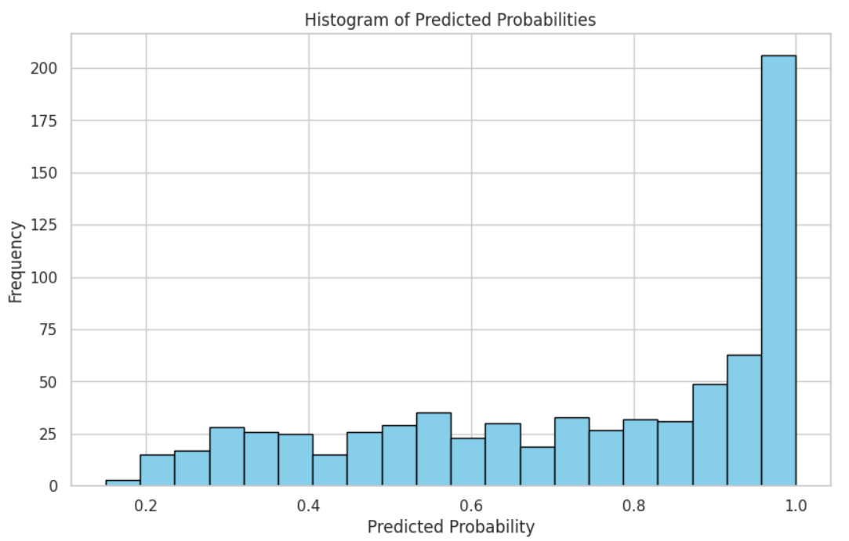
Visualizations & Results for 5000 image Dataset

Slide 15
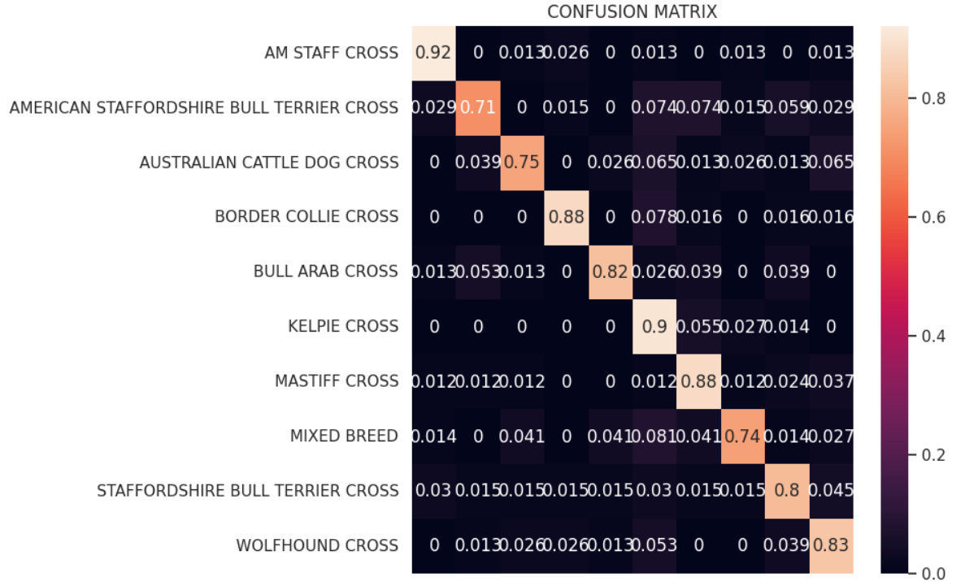
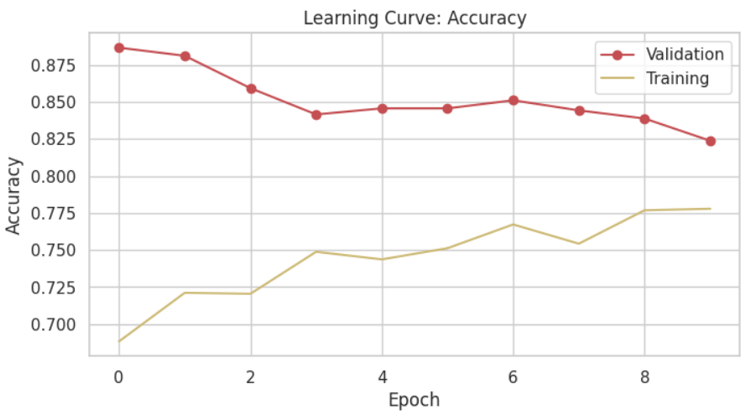
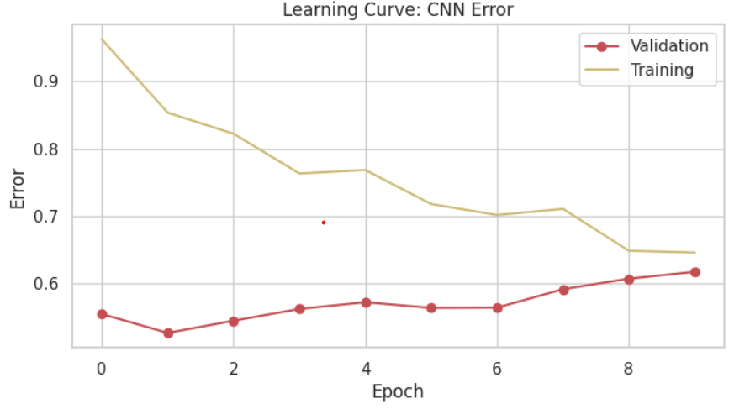
Visualizations & Results for 5000 image Dataset

Slide 16
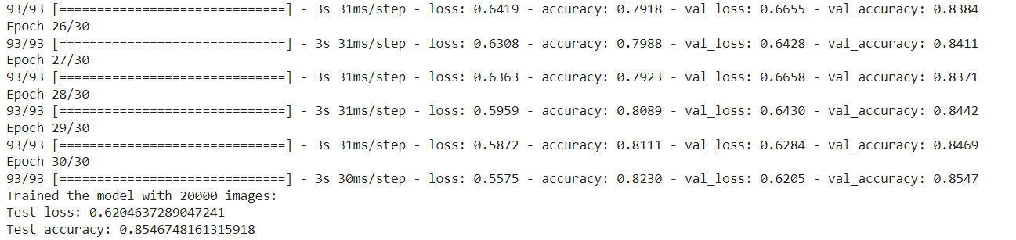
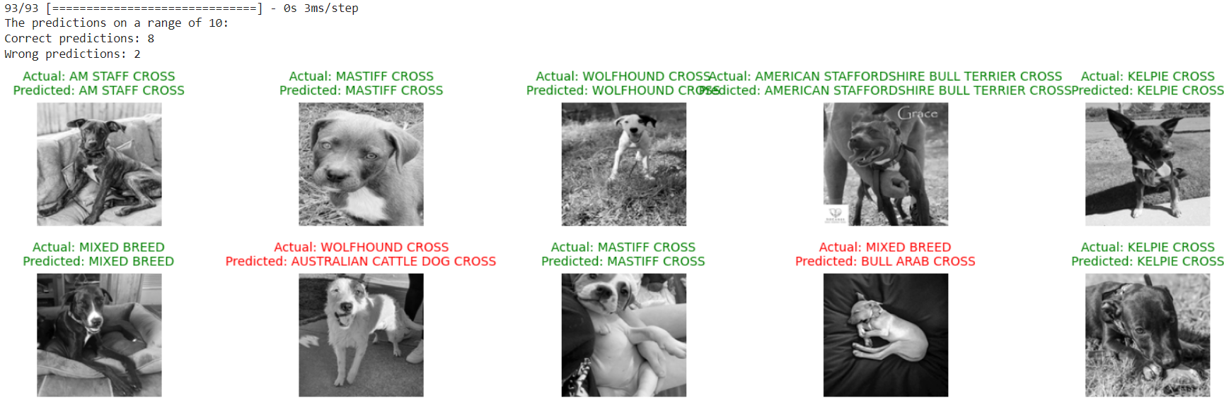
Training for 20000 image Dataset

Slide 17
Visualizations & Results for 20000 image Dataset

Slide 18
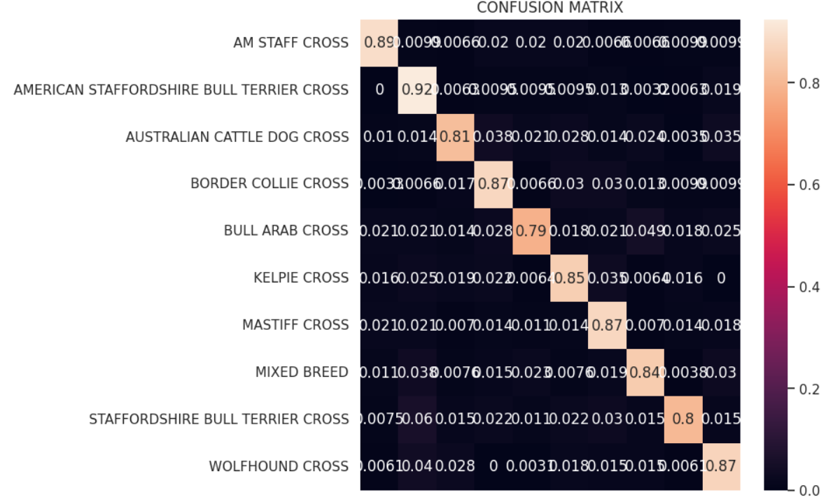
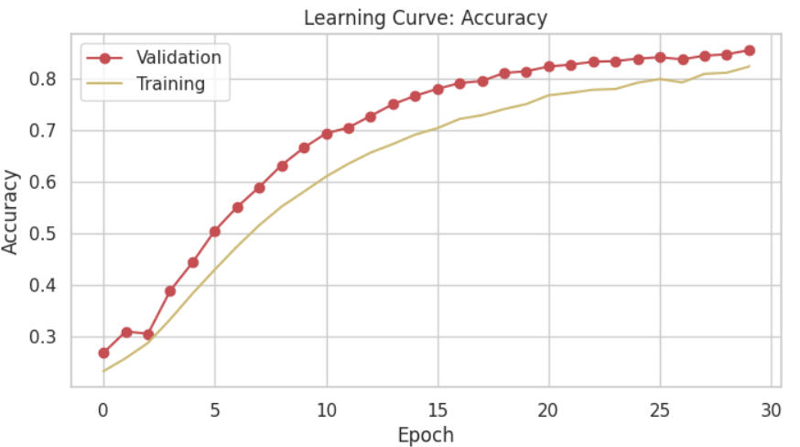
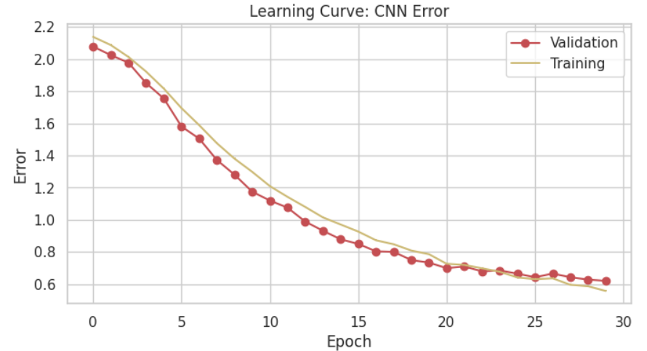
Visualizations & Results for 20000 image Dataset

Slide 19
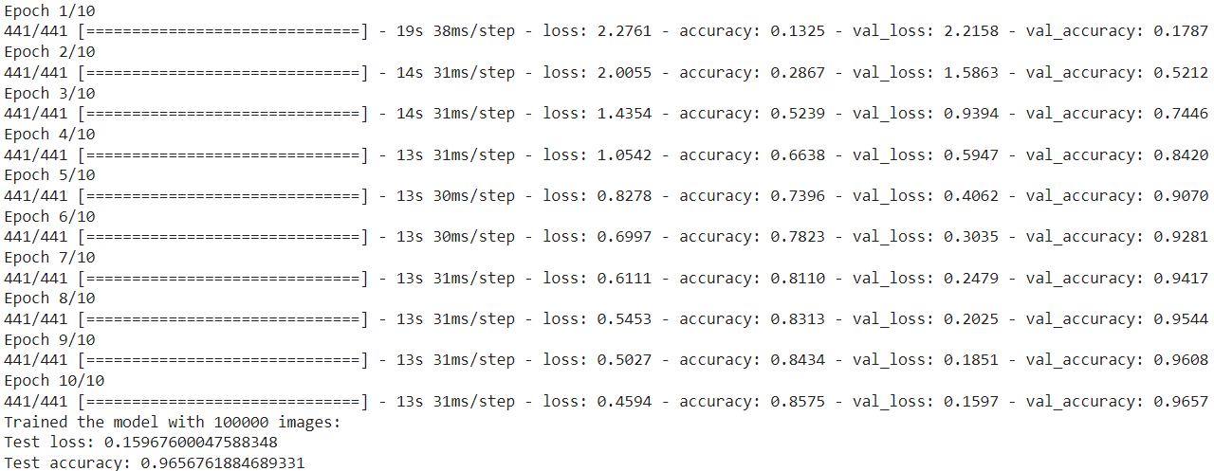
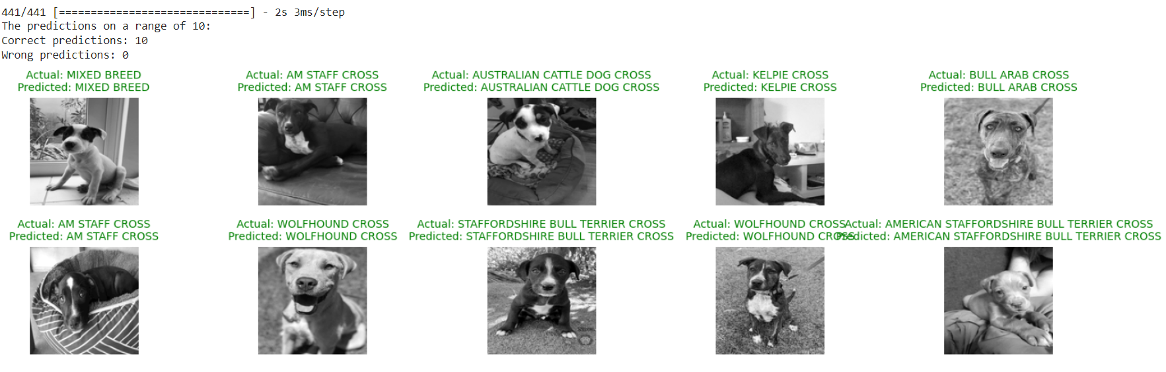
Training for 100000 image Dataset

Slide 20
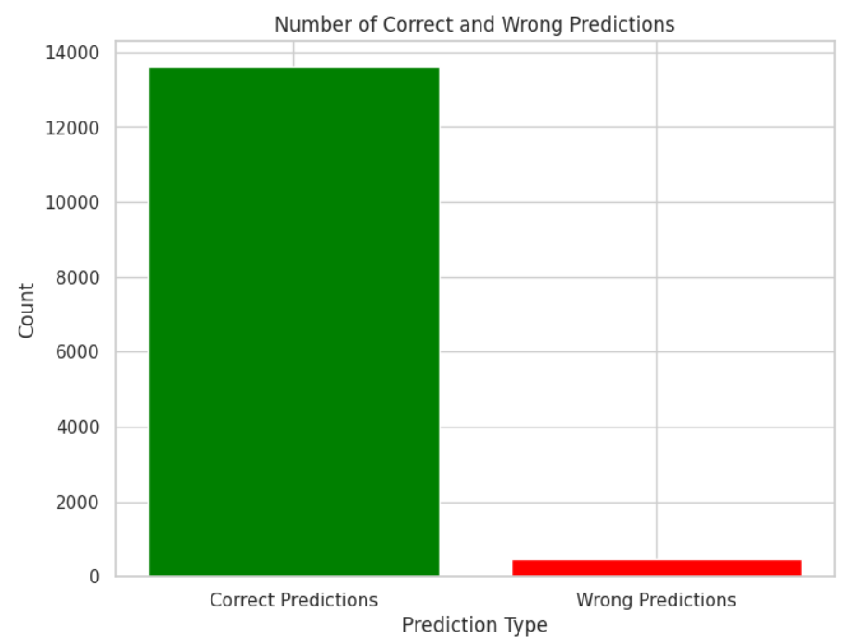
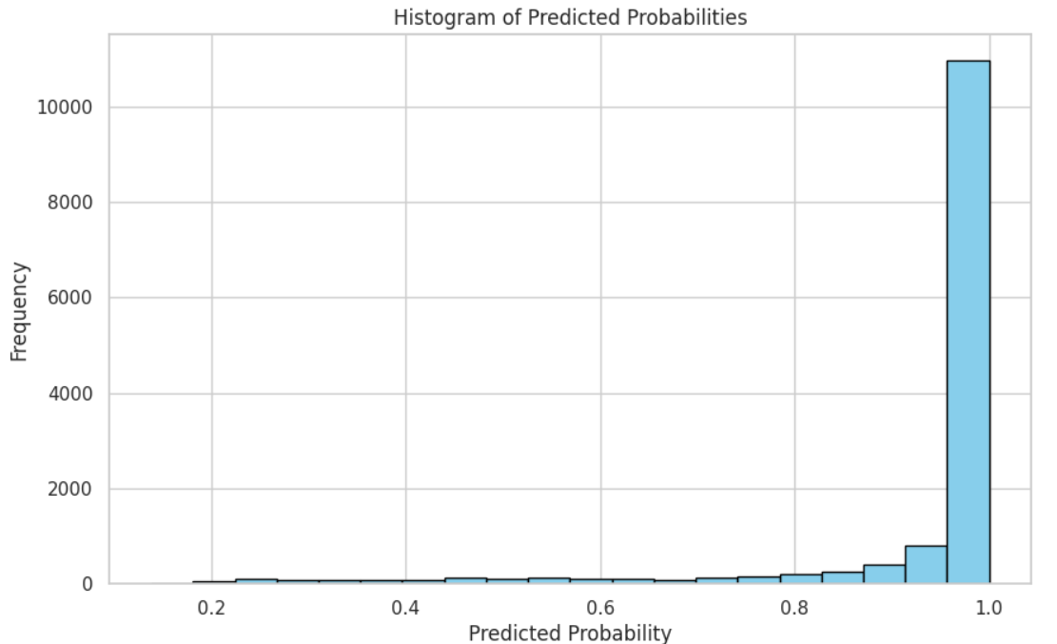
Visualizations & Results for 100000 image Dataset

Slide 21
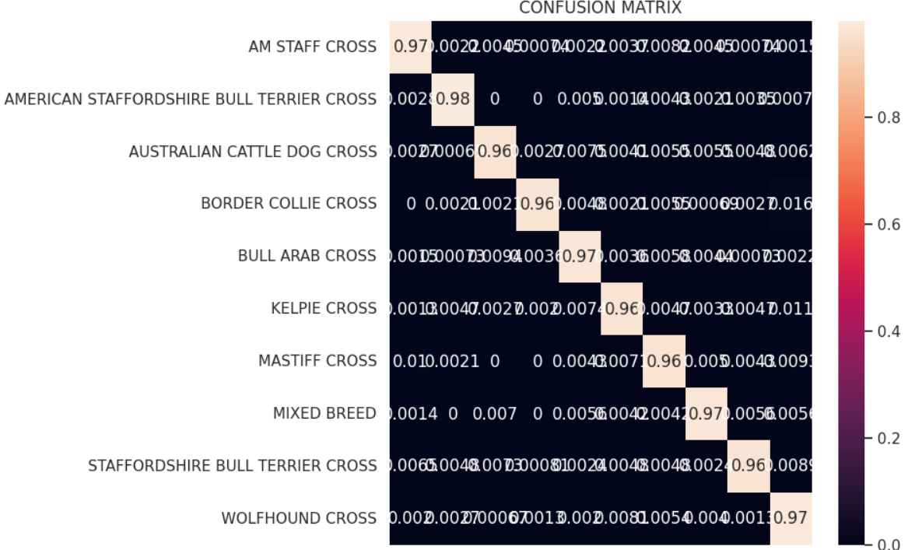
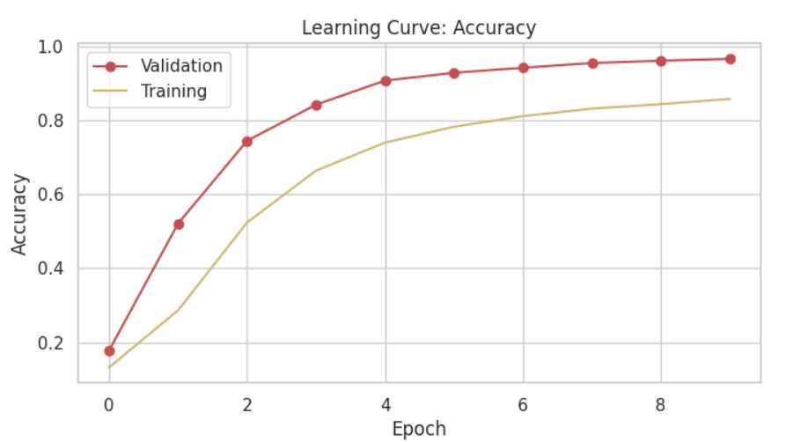
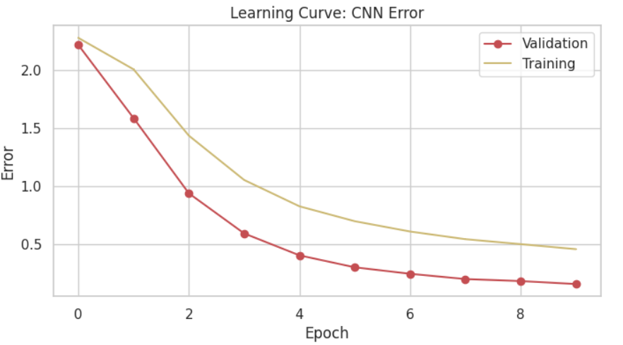
Visualizations & Results for 100000 image Dataset

Slide 22
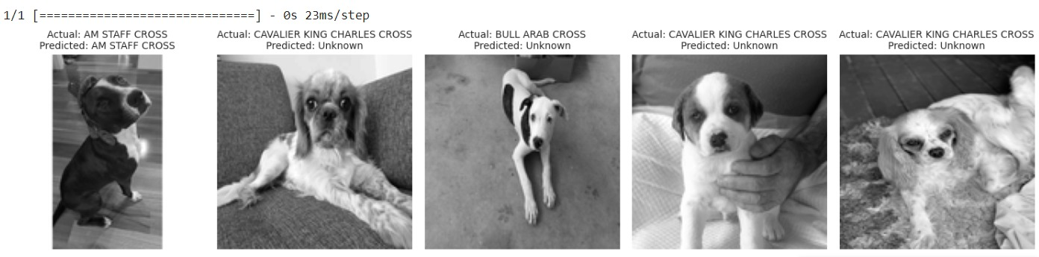
Observations
2000 Samples: 69% Accuracy — Initial performance baseline.
5000 Samples: 82% Accuracy — Noticeable improvements.
20000 Samples: 85% Accuracy — Consistent gains.
100000 Samples: 96% Accuracy — Achieved optimal performance.
We have also tried to run the model on unknown dataset which consists images of different breeds that are not used for any training.

Slide 23
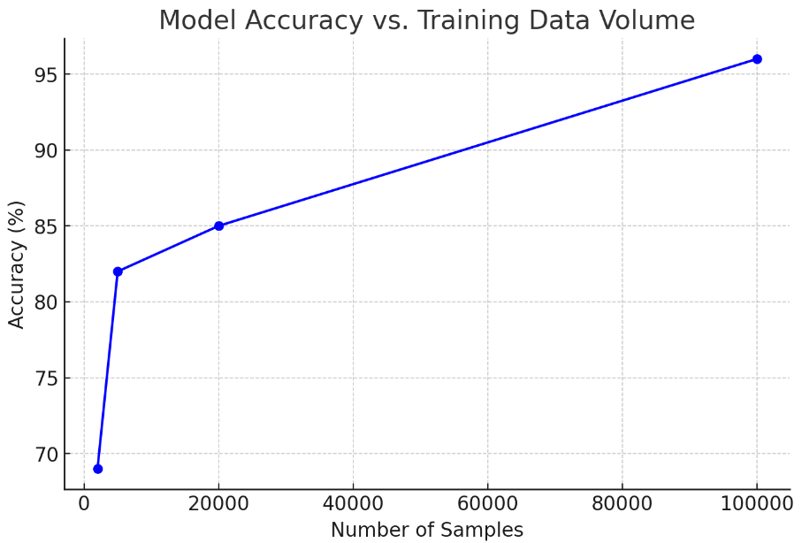

Graphical Insight:
"A line graph depicting a clear positive trend in accuracy as training data volume increases, emphasizing the model’s scalability."
Accuracy of 100000 samples: 96%

Slide 24
Conclusion
Successfully engineered a high-performance dog breed classification system using Apache Spark and MongoDB, achieving peak accuracy of 96% with extensive training data.
Demonstrated robust handling and processing of massive datasets (up to 20GB) with big data technologies, showcasing effective scaling and data management capabilities.
Explored and compared various data processing platforms. Identified Databricks for its integration capabilities, although limitations in the free version highlighted file size constraints.
Cloudera presented challenges for Python integration, leading to an exploration of Scala for improved compatibility and efficiency.
Employed cloud computing solutions to streamline our system architecture, significantly reducing setup complexity and enhancing operational efficiency..

Slide 25
Lessons Learnt
Learned to navigate the integration complexities of combining Spark, MongoDB, and Python. The successful integration after initial setbacks demonstrated the importance of persistence and strategic problem-solving in overcoming technology compatibility issues.
Mastered complex data extraction and management techniques with MongoDB. This experience highlighted the critical role of precision and meticulous planning in handling large datasets, ensuring data integrity and usability for machine learning applications.
Worked on a 20GB dataset across Cloudera and Databricks, familiarizing ourselves with various big data environments.
Developed proficiency in Spark programming, crucial for efficient big data processing.
Learned to implement CNNs effectively, optimizing model training on large-scale data.
Explored GPU capabilities for improved data processing and model performance.

Slide 26
References
Apache Spark https://spark.apache.org/docs/latest/
(2) Mongodb https://www.mongodb.com/docs/
(3) CNN for Deep Learning https://towardsdatascience.com/a-comprehensive-guide-to-convolutional-neural-networks-the-eli5-way-3bd2b1164a53

Slide 27
Thank you

